Slide 1

Henderson Construction Company Case Project, Part 1
Group: Base Ninjas
Subhransu Nanda, Bosky Mathew, Nagarjuna Basupalli, Pa Vang

Slide 2
Background
Henderson Construction Company
A State Qualified Highway Contractor in Indiana
It was started about 10 years ago by Patrick and Bob Henderson
Specializes in small bridge projects
3.5 to 5 million dollars in gross revenue
New Opportunities
Growing business
Many new projects are published by State every month – ready to submit the bid

Slide 3
Challenges
Paper Based Payroll System
Single Person Managing Paper-works for 50 Employees
Manual Errors – Unhappy Employees
Legal and regulatory environment has changed
Complying with various State and Federal wage scales, regulations and Equal Employment Opportunity Commission (EEOC)
Paper Based Inventory System
Huge inventory to manage and maintain in Books
Manual data entry errors
Not able to track the inventory items
Not able to track the maintenance schedules of inventory items

Slide 4
Proposed Solution
Create a Software System
Payroll Management function
Inventory Control functions
Software System should use a Database to store and maintain the data
Advantages of Database
Store Data in an ordered manner – Tables and Relationships
Reduce data redundancy
Example: Mary will not have to keep entering the same information each period pay for timecards
Preserve data integrity
Increases chances of data being accurate and consistent.
Faster Access to Data
Example: Easy to generate new reports to submit to State/Federal agencies

Slide 5
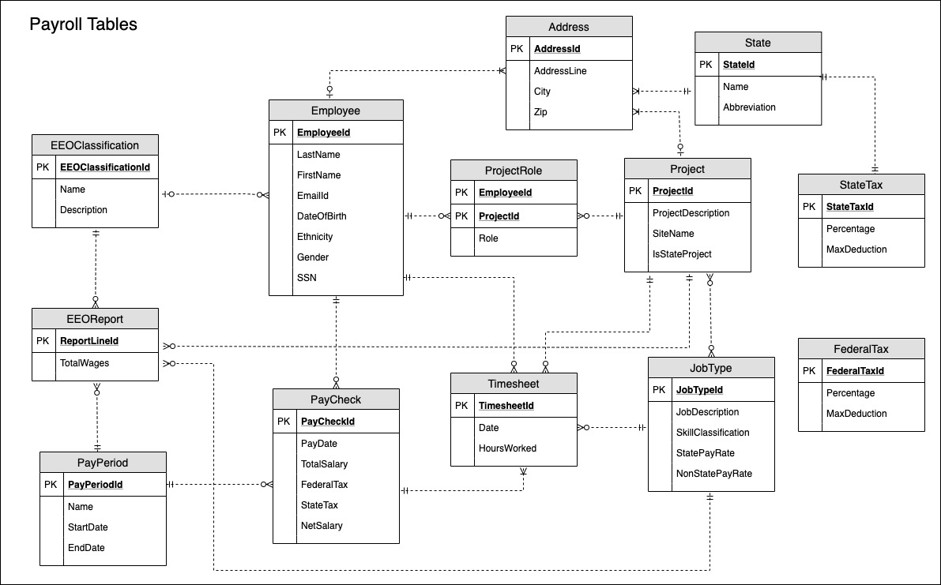
Data model- Payroll Management System

Slide 6
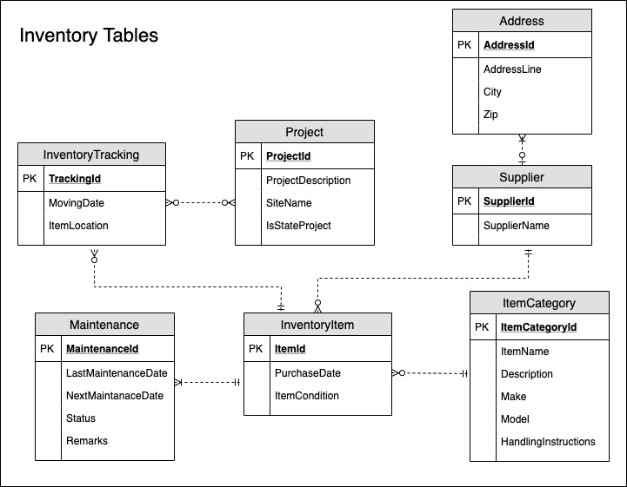
Data model- Inventory Control System

Slide 7
Next Step
Creating Physical Data Model
Creating Database Tables and Relationships
Creating Front-end Application by Application Development Team

